Slide 1
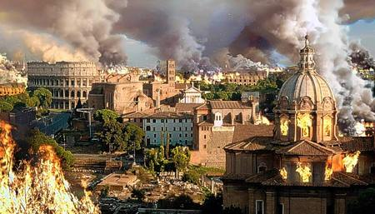
Fall of the Roman Empire
Alaina Taylor
2-16-16
4th

Slide 2
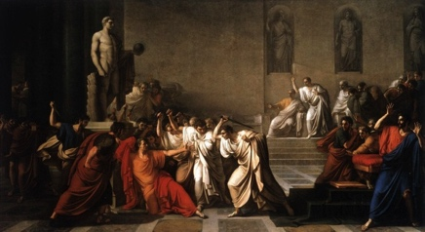
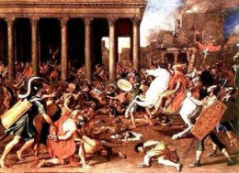
What were Rome’s problems? (political, social, economic, military)
Rome had great difficulty finding good rulers. At one point, they had 22 different emperors. As a result, talented people wouldn’t serve in the government. Problems began to increase, people stopped paying taxes, going to school, and some even became slaves. Government began to weaken, so law and order did as well. Soldiers destroyed fields, ceasing food growth and causing great hunger. People produced less goods and everyone lost money. A weakening economy meant that less people paid taxes, so generals were unable t0 pay soldiers. This caused protection to decline and Rome began to get attacked everywhere by everyone.

Slide 3
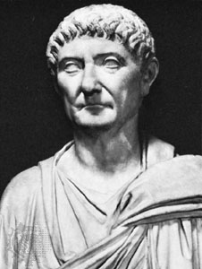
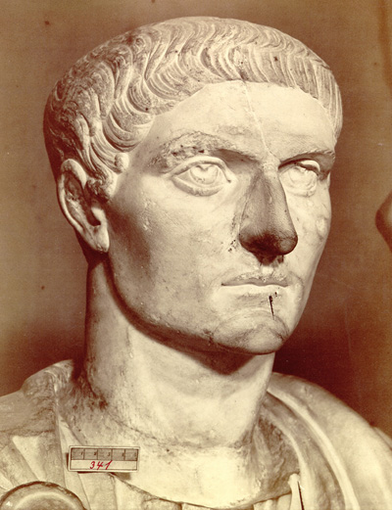
What changes did Diocletian & Constantine make?
In 284 a man named Diocletian became the emperor of Rome. He began to establish rules and systems to try and slow the decline. He divided Rome into 4 parts and assigned a ruler to each. To decrease inflation, he set prices for goods and the salaries that people would be paid. However, no one obeyed these rules and ideas, so Diocletian was forced to retire. Then in 312 a new ruler named Constantine took over. He too tried to set certain rules for the people of Rome. His main rule was that sons had to follow their father’s trade. So, whatever the father did for a living, the son would also. His changes didn’t stop the decline either, so he moved the capitol to a different city named Byzantium. He then built many buildings and called this land Constantinople.
Diocletian Constantine

Slide 4
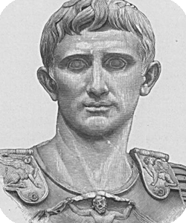
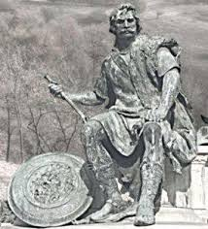
Who invaded Rome and why does it fall?
By this point, Rome was very weak in about every area. They could no longer hold back the Germanic tribes. These included the Ostrogoth’s, Visigoths, Franks, Vandals, Angels, and Saxons. They sought after Rome’s better climate and land. However, out of all the groups, Rome had the most trouble with the Visigoths. Romans began to make them buy food at high prices and even kidnapped some of their people. The Visigoths finally rebelled and defeated Rome in the battle of Adrianople. The Rhine river then froze so the Germanic tribes were able to cross it and invade Rome. This was the first time Rome had been conquered in 800 years. In 476, a Germanic general named Odoacer took over and overthrew the western emperor named Romulus Augustulus. Historians believe that this was when Rome finally “fell” because there was never another ruler of Rome.

Slide 5
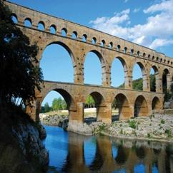
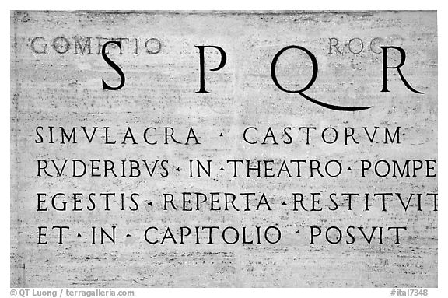
What was Rome’s legacy? (influence on gov, religion, culture)
Many of the things that we still participate in today were influenced by Roman ways. Our language, laws, and architecture mainly started with them. Christianity actually began to spread during their time. The earliest form of Roman law was the 12 tables, which we still use today. Other concepts such as perceiving a person innocent until proven guilty, all citizens are equal, and a republican government came from them. Their biggest impact on religion was the spread of Christianity in the 300s. Many parts of our culture also came from them. We adapted many words and phrases after the Latin alphabet and language. They began with a 22 letter alphabet and we changed it to 26. Lastly, we got a lot of building techniques from them. Because of the Romans, we still use concrete, domes, and arcs in many buildings.

