Slide 1
What Was family life like in Rome?
Alaina Taylor
2-9-16
4th

Slide 2
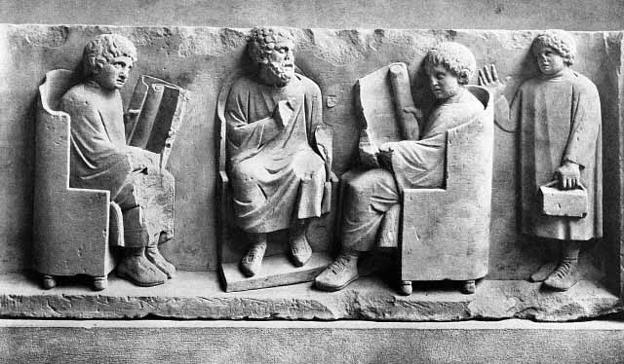
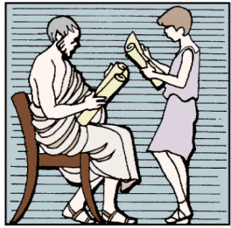
Education
The main things that roman children learned at school was reading, writing, and rhetoric or public speaking. Poor Romans were not able to send their children to school, however, wealthy Romans hired tutors to teach their children at home. Older boys attended school and learned all of the main subjects. Older girls learned at home and were also taught household duties.

Slide 3
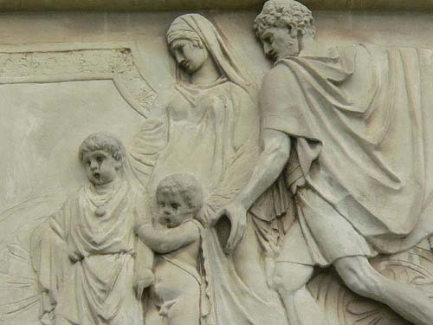
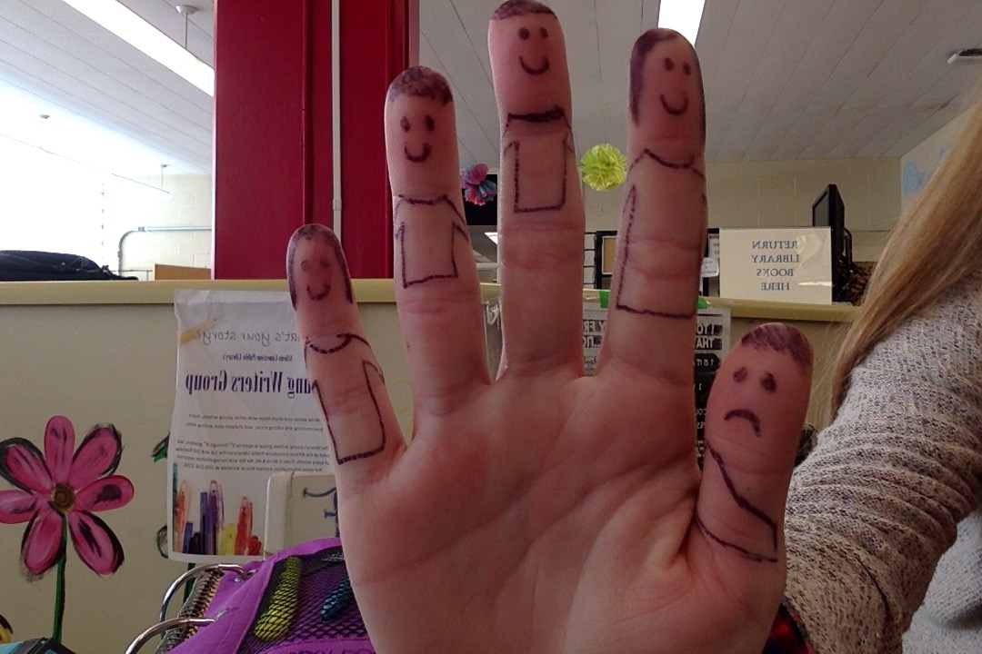
Who all lived In the home?
Most Roman households included the father, often called “Paterfamilias,” which means father of the family. He had full control over the family members and punished the children severely. Then you had his wife, children, and other relatives. If the family was upper class, slaves and servants also lived in the house.

Slide 4
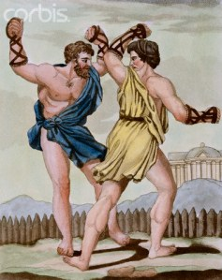
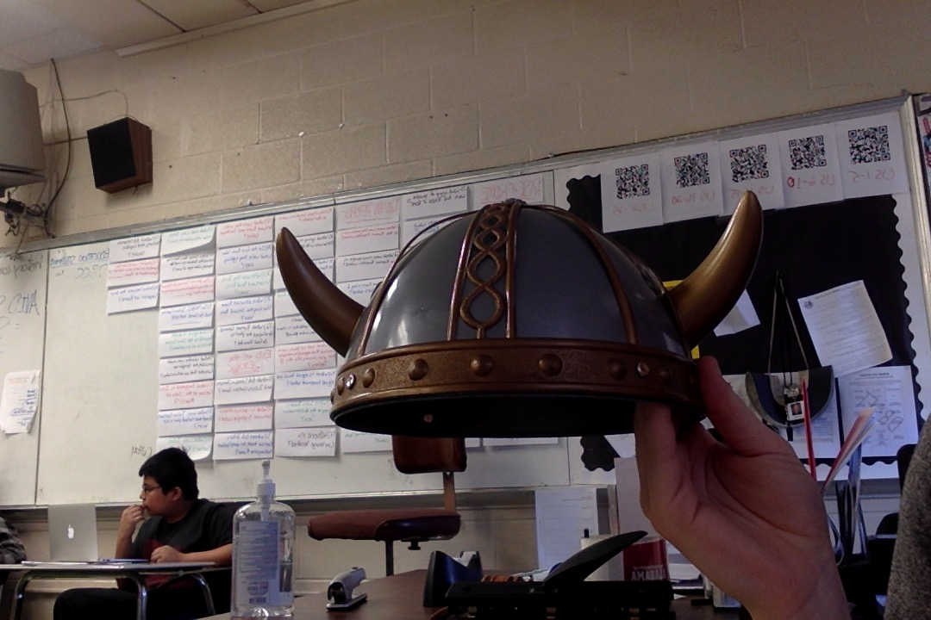
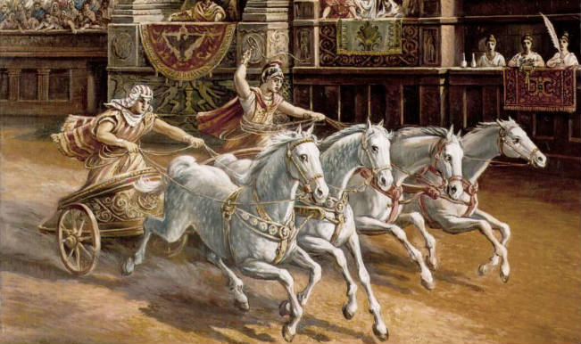
Roman Sports
Roman sports mainly involved men and were very brutal. The first type of sports were played at wealthy peoples’ villas. The men that participated in these sports included slaves that lost their citizenship, slaves, and prisoners of war. The main sports that were played involved boxing, chariot racing, and gladiator battles.

